Slide 1




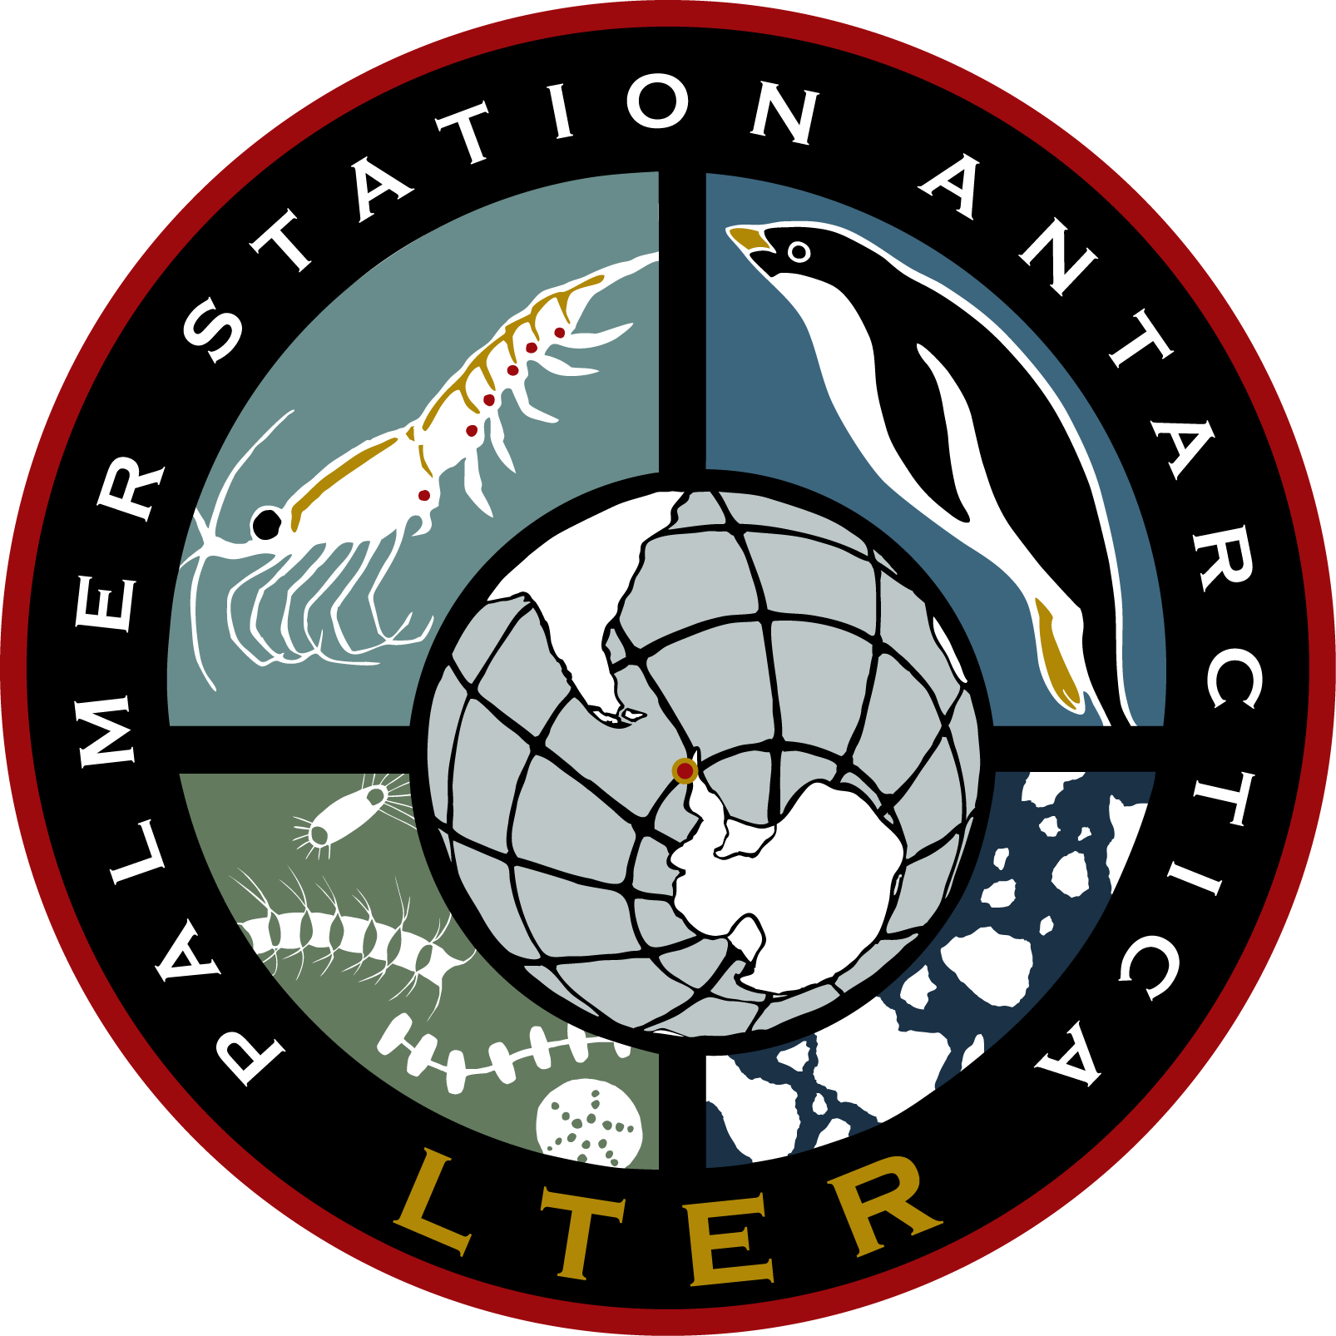

Satellite Driven Studies of Climate-mediated Changes in Antarctic Food Webs
April 22, 2015
Matthew Oliver, Megan Cimino, Andrew Irwin, William Fraser, Josh Kohut, Oscar Schofield, Mark Moline, Donna Patterson, Vince Saba

Slide 2
Penguins from satellites…are you insane?
Matthew Oliver, Megan Cimino, Andrew Irwin, William Fraser, Josh Kohut, Oscar Schofield, Mark Moline, Donna Patterson, Vince Saba

Slide 3
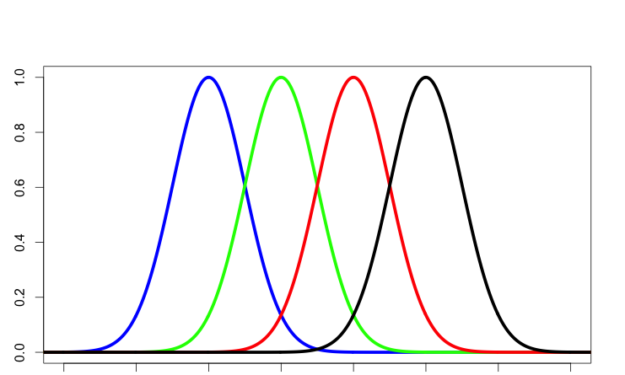
Short Food Webs Increase Chance of Prediction
Hypothesis: Environmental Trends Predict Upper Trophic Levels
Look for places with big environmental perturbations, and short food webs.
Enormous interest in conservation
Krill
Penguin
Phytoplankton
Environmental Change

Slide 4
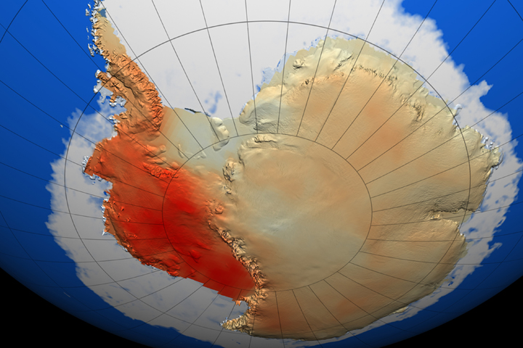

West Antarctic Peninsula is Rapidly Warming and Losing Ice
Penguins
Krill
Climate Perturbation

Slide 5
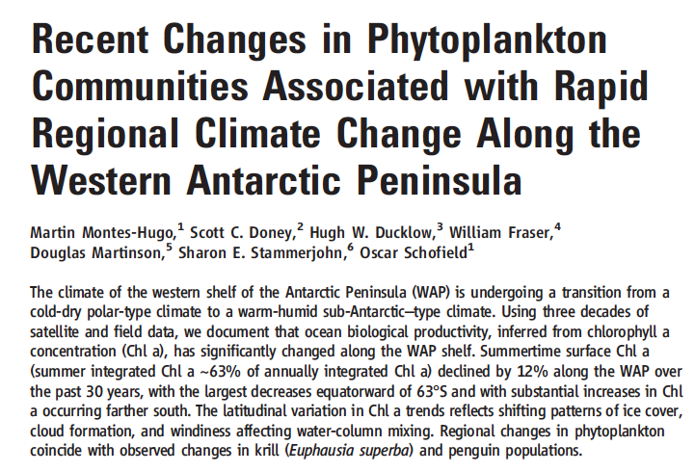
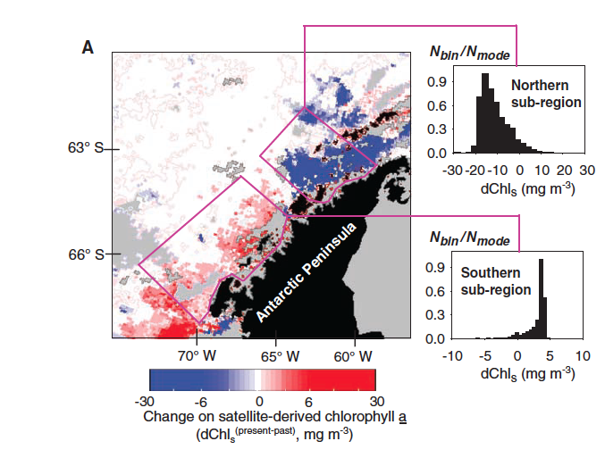
The changes in phytoplankton are at least regional (West Antarctic Peninsula)
West Antarctic Peninsula Losing Sea-Ice
Penguins
Krill
Climate Perturbation

Slide 6
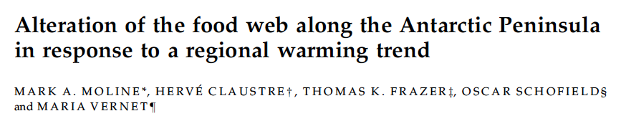
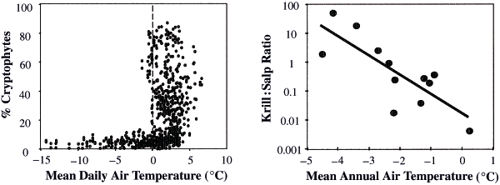
Changing Phytoplankton Community Composition in the WAP
Krill can not eat cryptophytes because they are too small

Slide 7
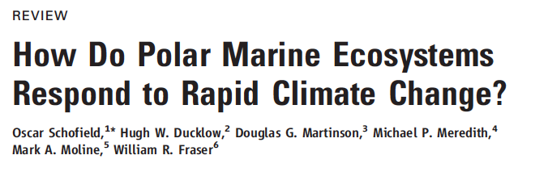

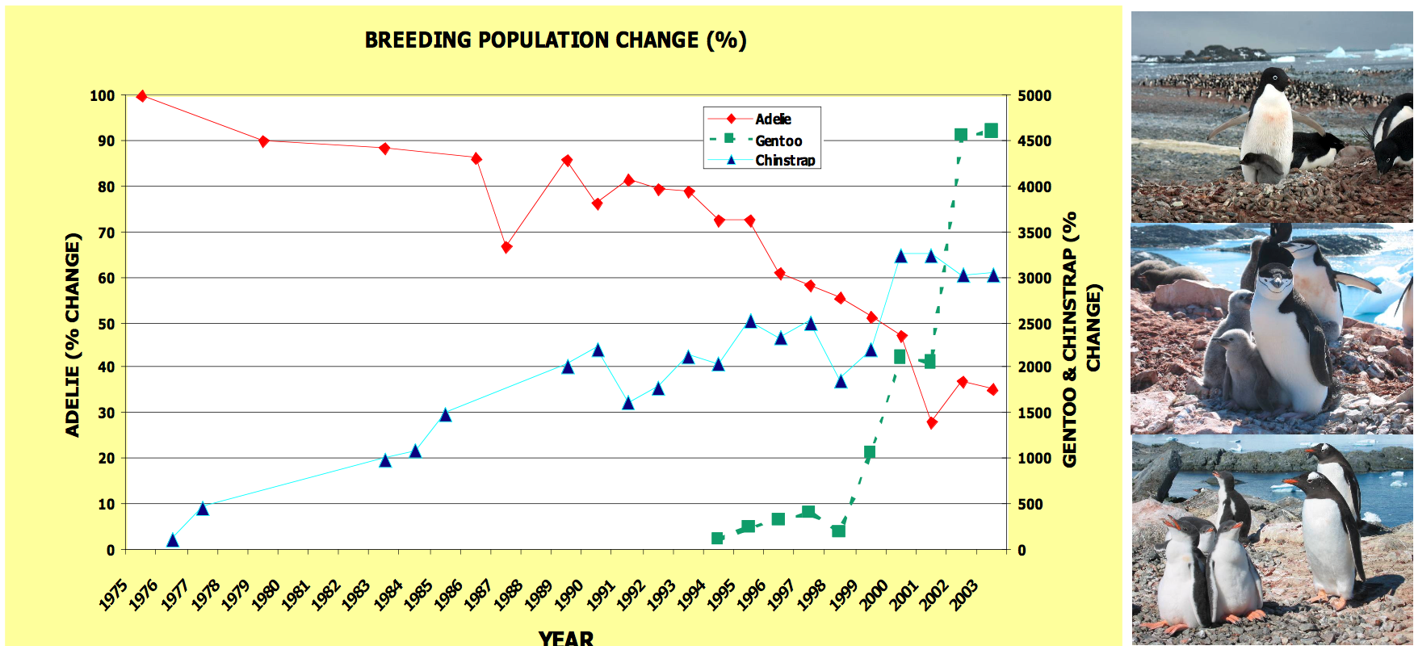
Background
Penguins are following suit with the change

Slide 8
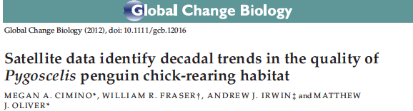
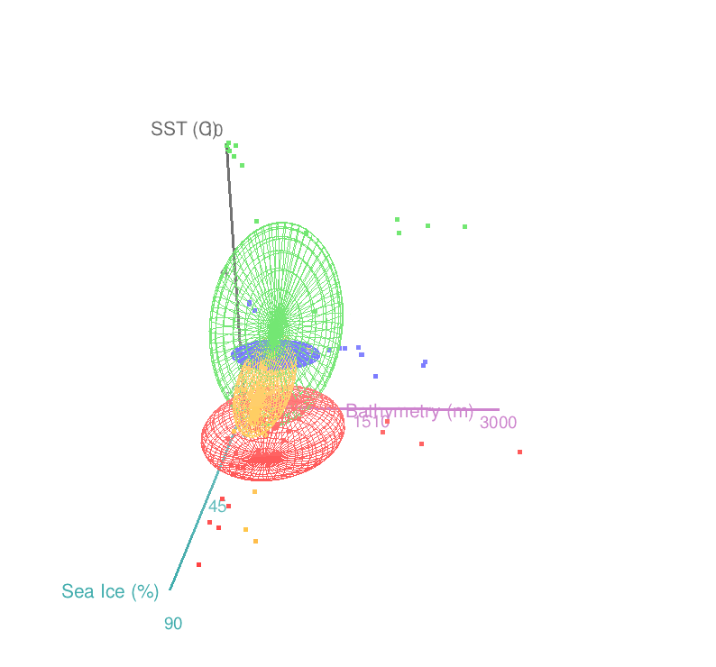
Continental
Adélie
WAP
Adélie
Chinstrap
Gentoo

Slide 9
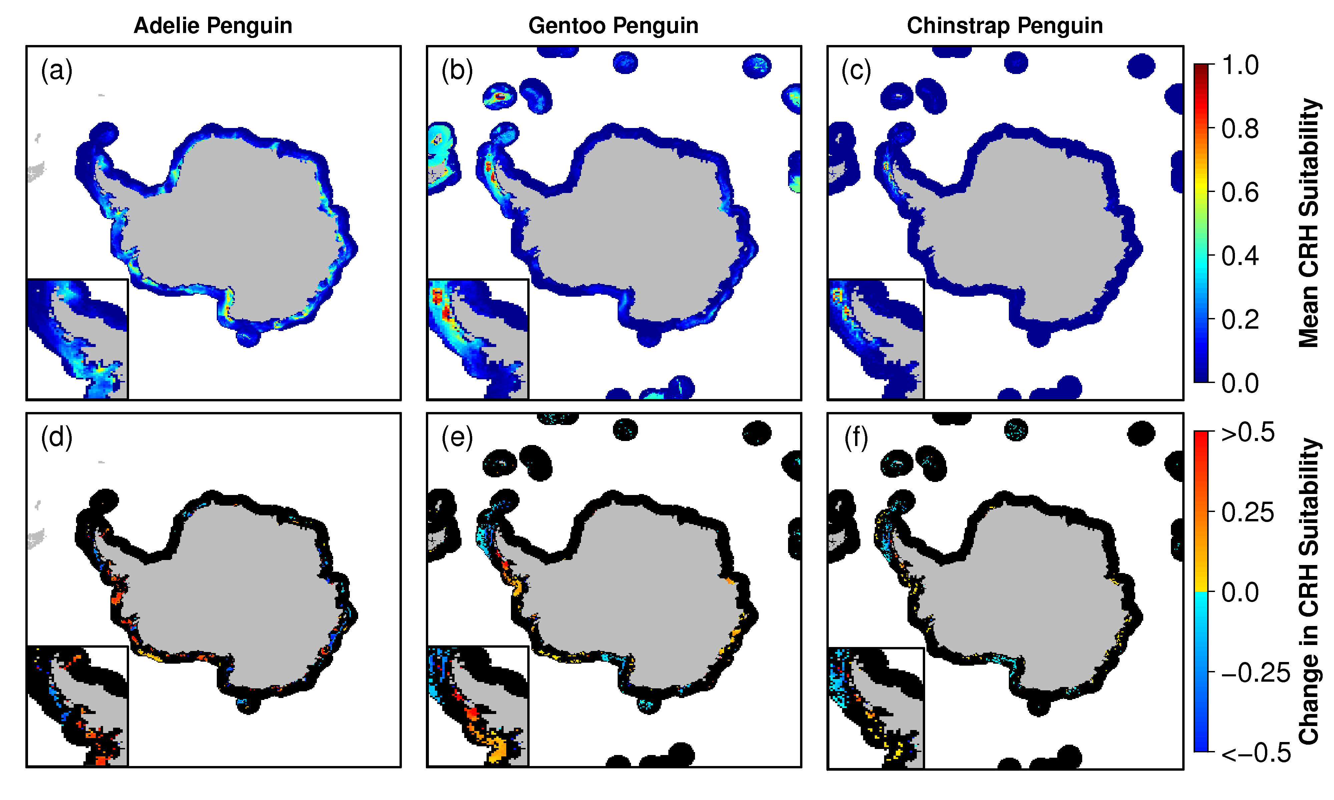
Quantify the distribution and the 30 year trend of CRH Niche Space
So What?
Notes:
0 and 1 of probability of presence.
The image uses colors to indicate predicted probability that conditions are suitable,
red indicating high probability of suitable conditions for the species,
green indicating conditions typical of those where the species is found,
lighter shades of blue indicating low predicted probability of suitable conditions.

Slide 10
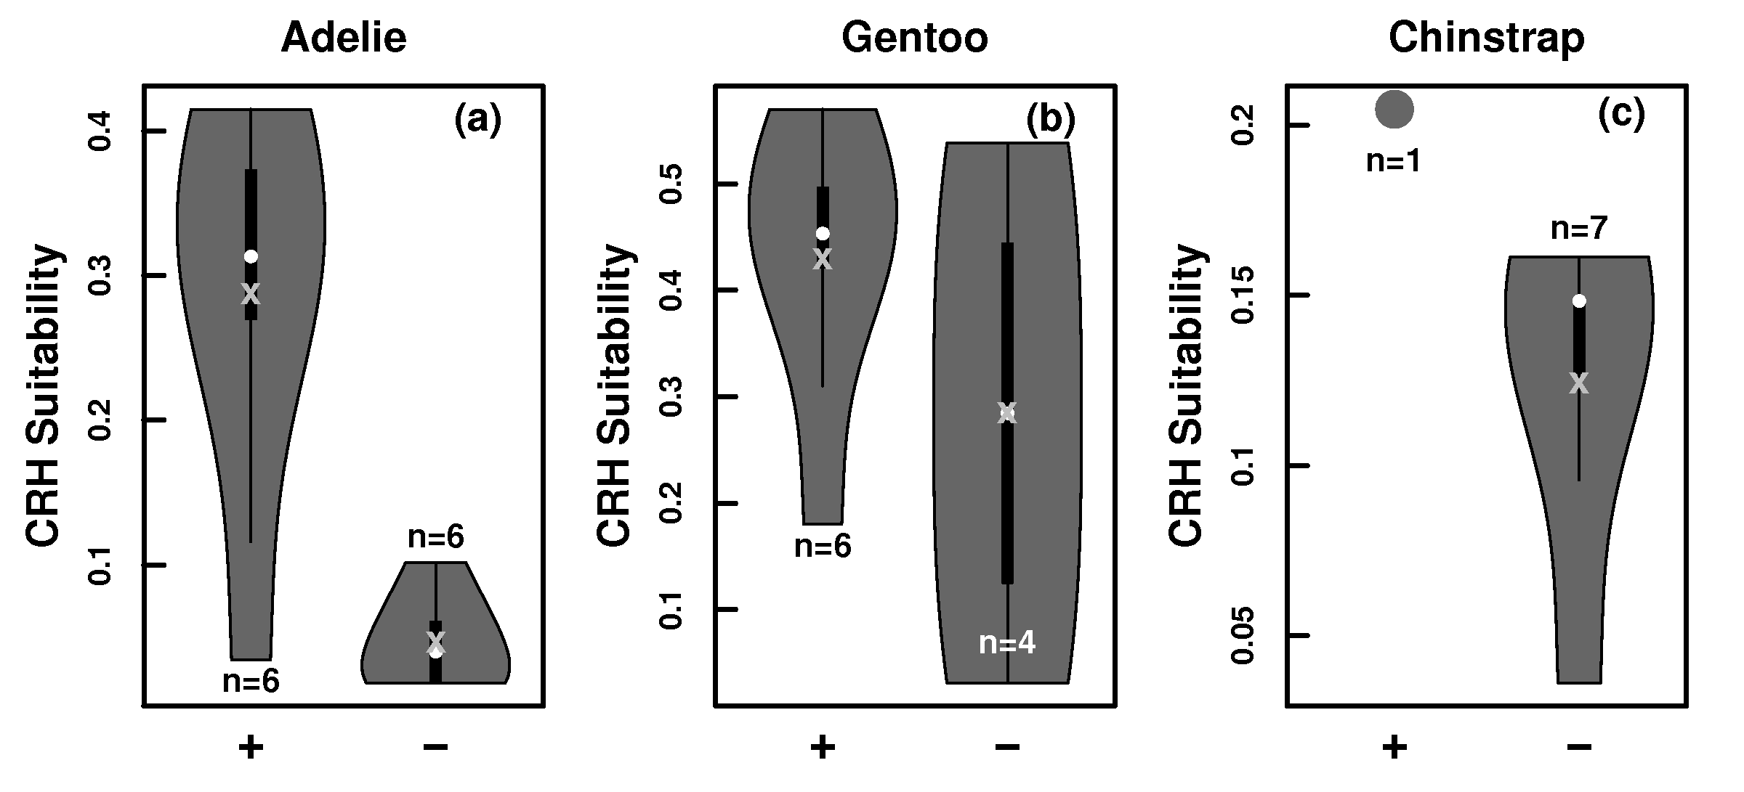
Environment predicts penguin population trend..sort of.

Slide 11
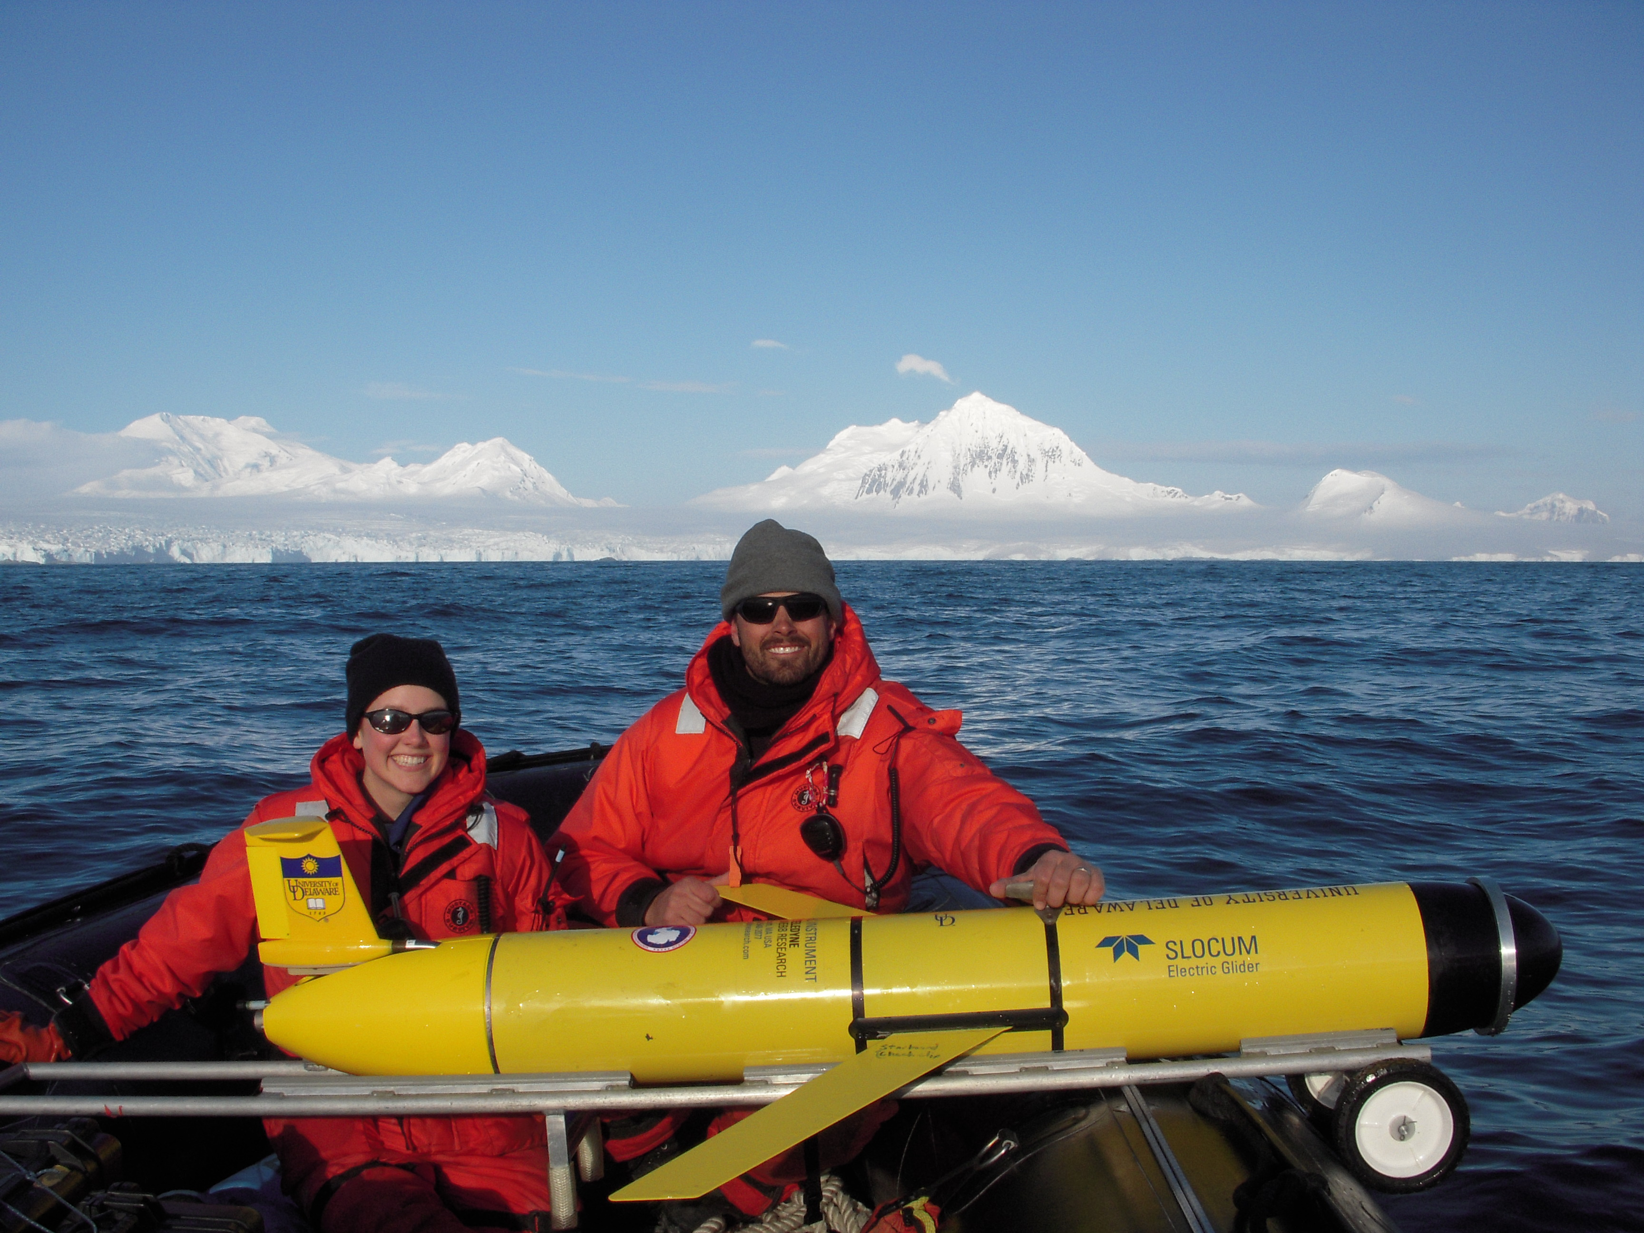
First Field Season Results
Glider AUV Depth Integrated Currents
Diurnal Tides
Semi-Diurnal Tides

Slide 12
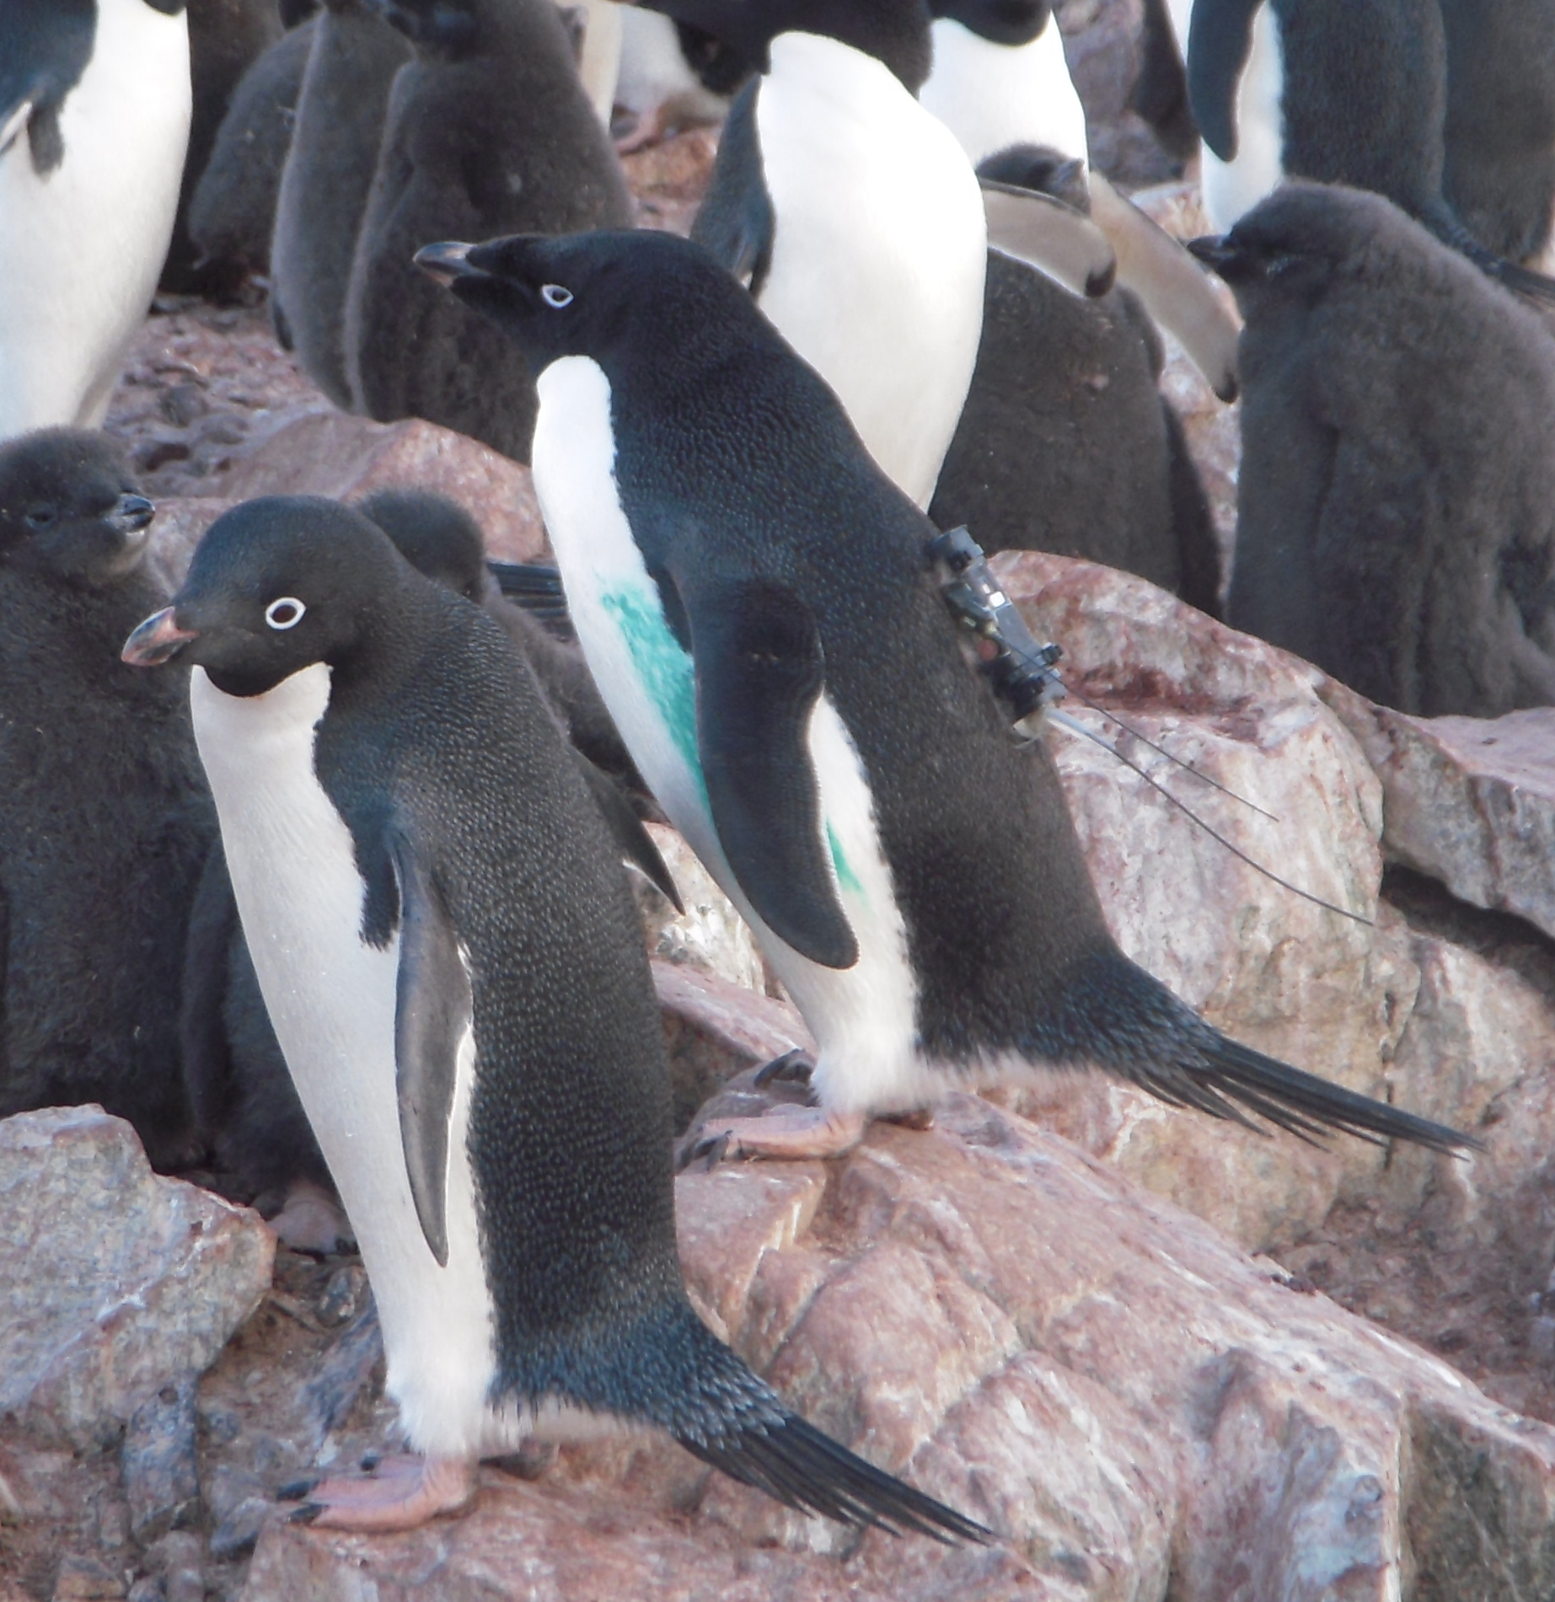
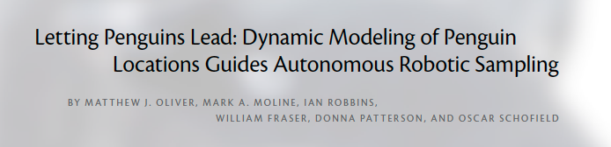
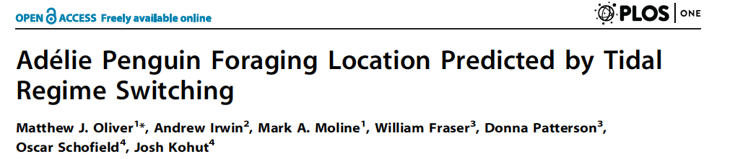
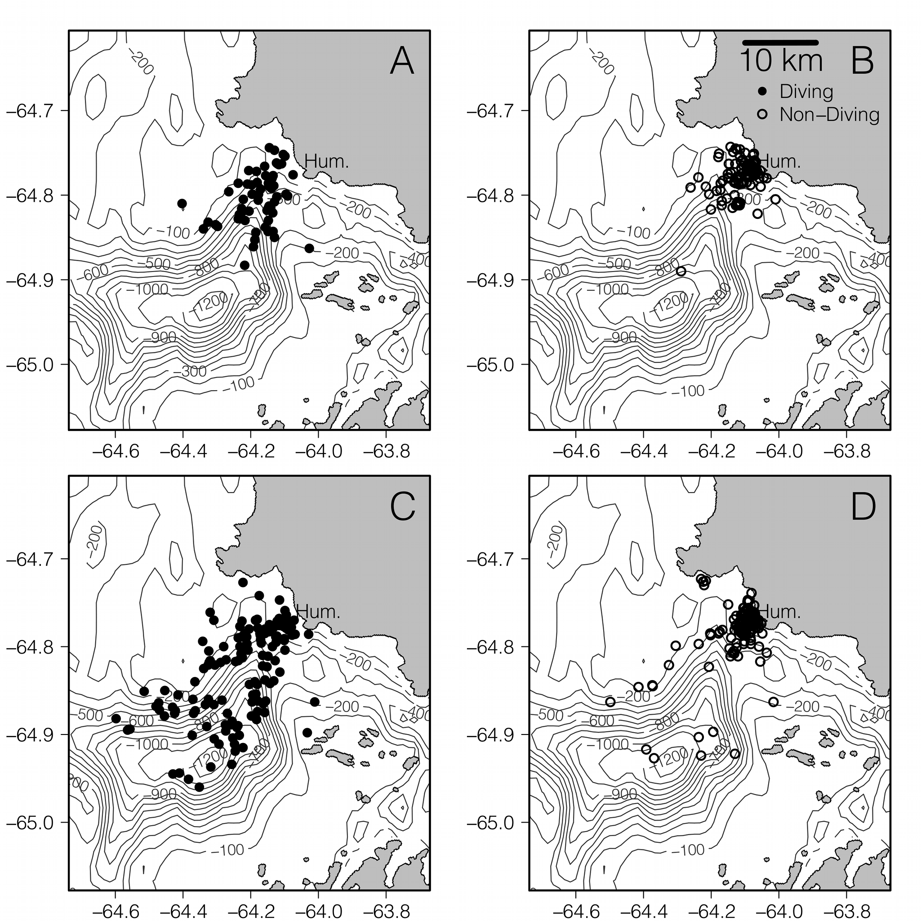
Glider AUV Currents allowed us to see the importance of tides on tagged penguins
Diurnal
Semi-Diurnal
Krill

Slide 13
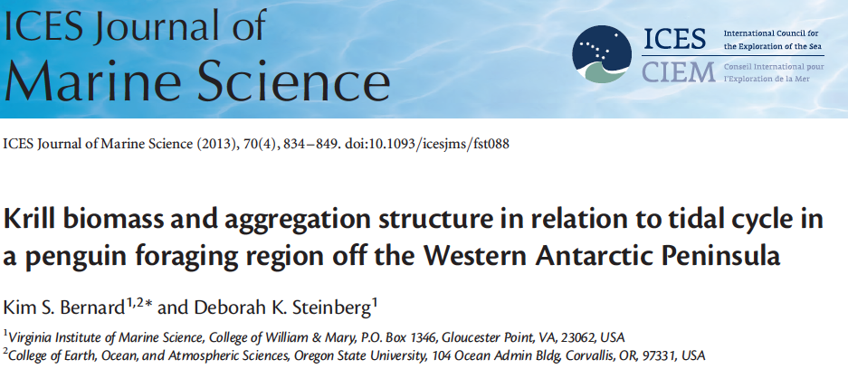
Nearshore Tidal and Offshore Comparisons of Krill
Smoking Gun?

Slide 14
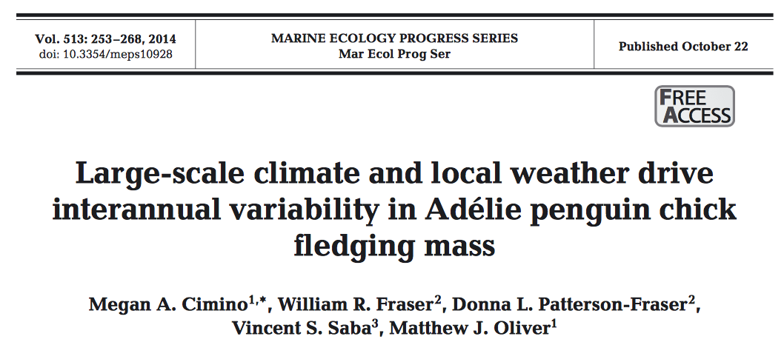
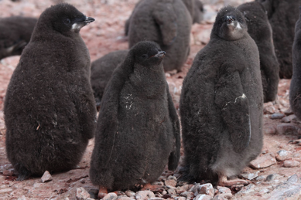
What drives chick weights?
Chicks are the Integrated Investment
What are the dominant drivers of this interannual variability?
  Large-scale climate?
  Local weather?
  Food quality?
  Tidal forcing?

Slide 15
Effects of Each Predictor Variable on CFM
~0.2 kg effect
~0.1 kg effect
  Climate and Weather Indexes were Dominant!
  Noticeable absence of tides!!!!!! Womp womp
  Thermoregulatory Issue

Slide 16
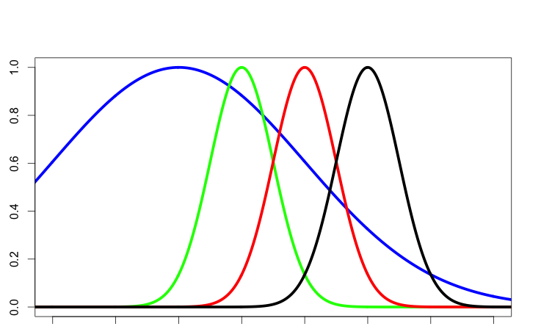
Krill
Penguin
Phytoplankton
Climate does not have to “pass-through” the food web to affect penguins.
There are direct mechanistic effects, which means it is predictable via remote tools
Environmental Change
Krill
Penguin
Phytoplankton
Environmental Change

Slide 17
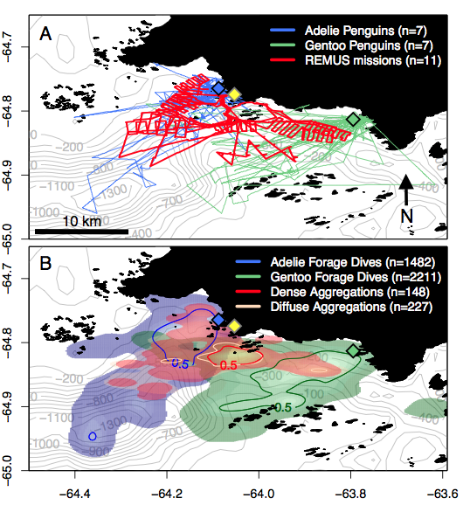
What about competition for krill resources?
2 Gentoo, 129 dives
7 Adelies, 243 dives

Slide 18
When foraging in the same location, foraging Gentoo’s avoid Adélie’s by going deeper
  Also, Steinberg et al. 2015 showed essentially no change in krill abundance from 1993-2013.
  The scarcity of krill is not a driving force.

Slide 19
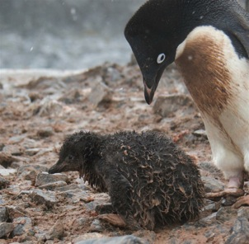
Penguins from space? Yes
We thought that climate would affect the bottom of the food web and ripple up to penguins
Satellite Driven Niche Spaces are fairly good at predicting general trends in penguin populations
Tides seemed like a good way to explain variation in the satellite predictions
A meta-analysis of Climate Scale and Local Scale drivers reveal that Climate (especially terrestrial) is the most important for understanding chick weights.
Ruled out competition for krill by Gentoo penguins
Working with Heather Lynch to extend satellite analysis (Lynch and Schwaller, 2014)

